Slide 1
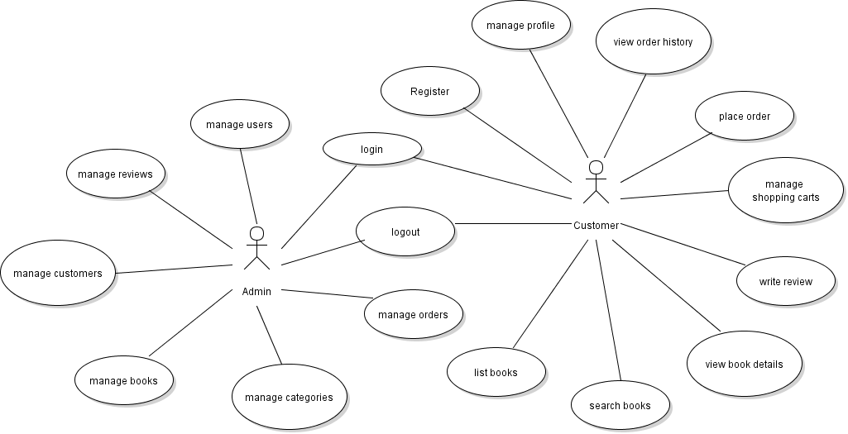
Implement Update Customer Profile Feature

Slide 2
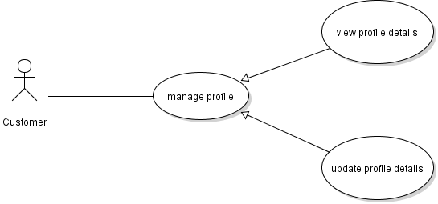
Use case diagram: Manage Customer Profile

Slide 3
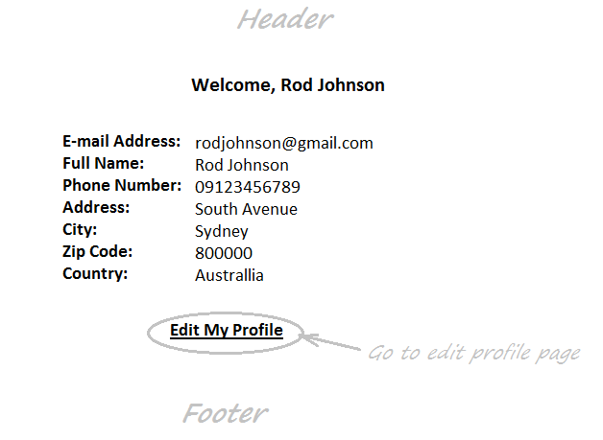
Customer Profile Page

Slide 4
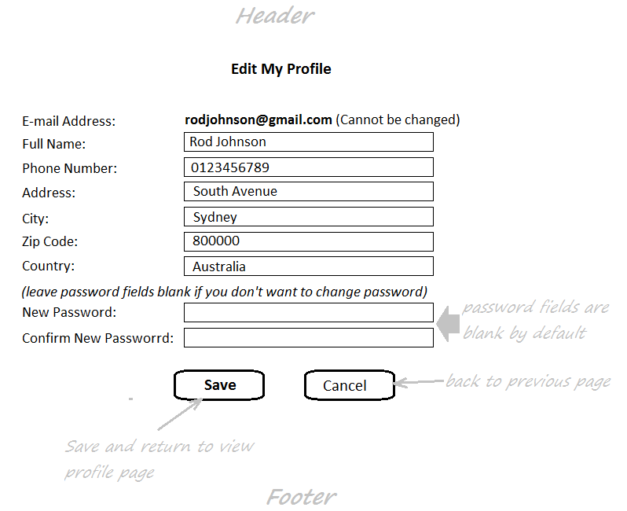
Edit Customer Profile Page

Slide 5
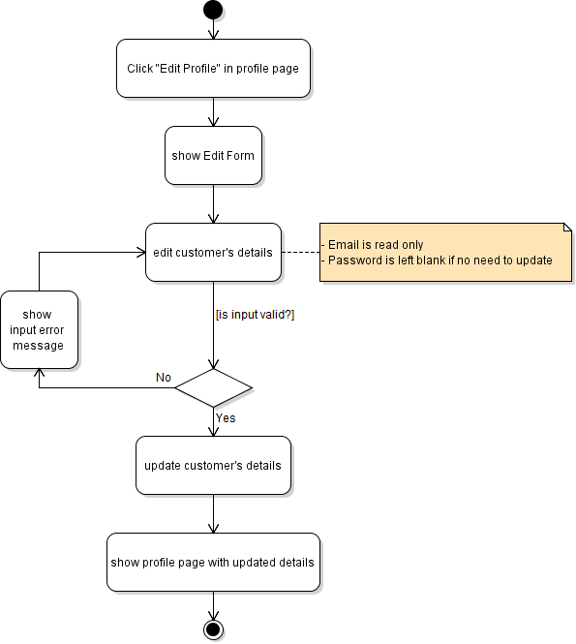
Activity Diagram: Update Customer Profile

Slide 6
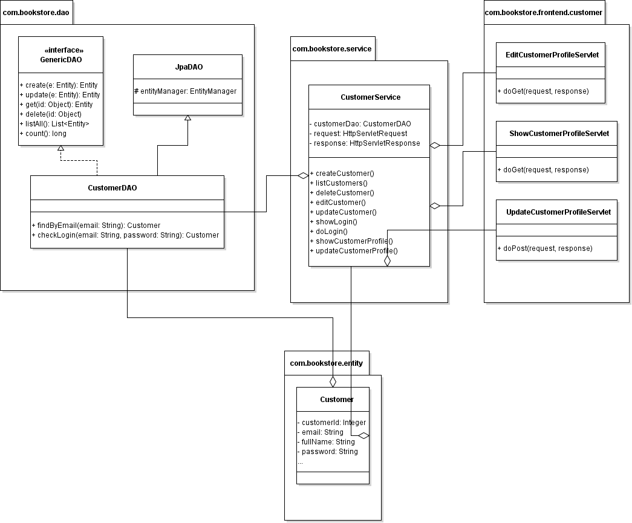
Class Diagram:

Slide 7
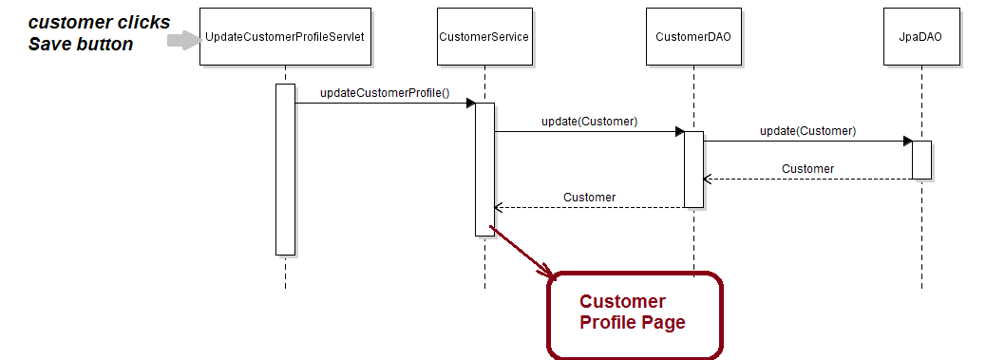
Sequence Diagram: Update Customer Profile

Slide 8
Similar task:
Code Customer Profile Page
Create EditCustomerProfileServlet
Code Edit Customer Profile Page
Create UpdateCustomerProfileServlet
Update CustomerServices class

